Slide 1
Credit Risk Analysis on Loans Application Data
EDA Analysis

Slide 2
Agenda
Objective
Describing Loan Application Dataset
Data Selection / Data Elimination
Missing Data Analysis
Outlier Analysis
Data Creation/Data Transformation
Addressing Data Imbalance
Univariant and Bivariate analysis with respective to target 0, 1
Correlation among Continuous Data Attributes in target 0 Data Set vs Correlation among Continuous Data Attributes in target 1 Data Set
Describing Previous Loan Dataset
Observation in categorical and Continuous Data
Univariant and Bivariate Analysis
Final Words

Slide 3
1 Objective
Aim is to identify patterns which indicate if a client has difficulty while paying their installments.
In other words, the company wants to understand the driving factors (or driver variables) behind loan default, i.e. the variables which are strong indicators of default. The company can utilise this knowledge for its portfolio and risk assessment.

Slide 4
2 Describing Loan Application Dataset
Data Size : 286.2+ MB
Number of Data Attributes Given: 122
Number of applications: 3,07,511
Note:
Not Applicable coded as XNA in categorical Columns
Not Applicable coded to large number for numerical columns
Missing Data mentioned with NaN

Slide 5
3 Data Selection / Data Elimination
Low Variance Columns Dropped.
Mobile Number Columns
Mandatory Documents Columns
Chooded Mode as a Metric for Living apartment measures

Slide 6
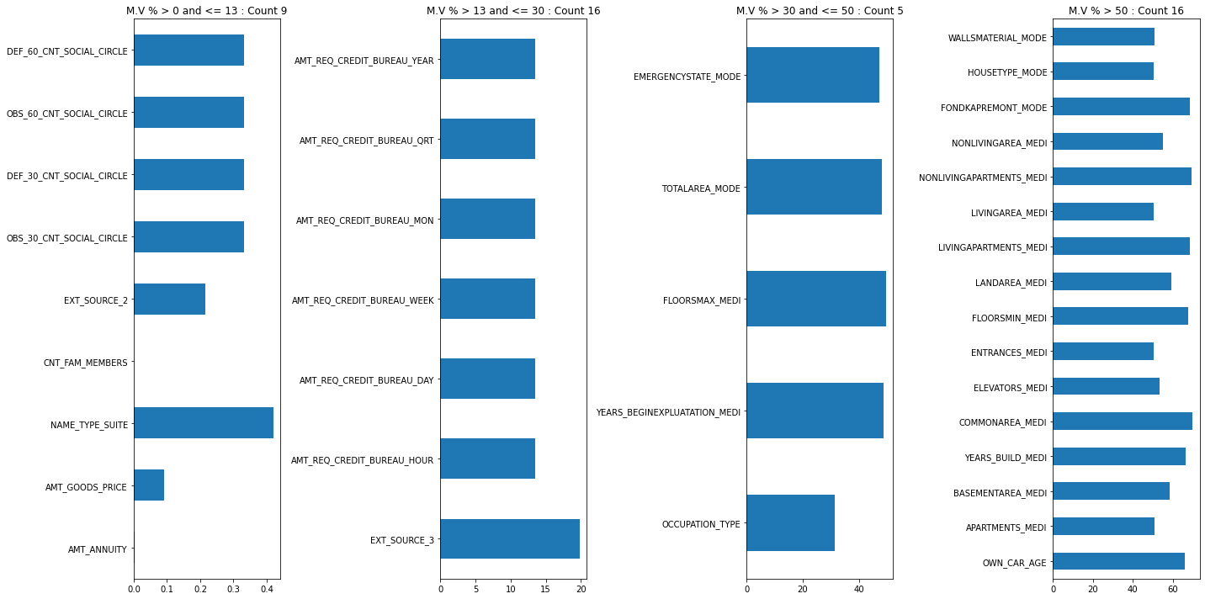
4 Missing Data Analysis
Missing values categorized into 4
groups
Attributes describing Building Status has more null values
Organization Type
has more null values. No other categorical data has these many null values

Slide 7
Imputation Recommendation for columns with null percentage < 13
Annuity
Group the data by ["NAME_INCOME_TYPE","NAME_EDUCATION_TYPE", "OCCUPATION_TYPE"] and find the respective AMT_ANNUITY median , then impute the missing value with that. For the imputation values please refer below dataframe
Family Members Count
We can impute missing values with mode of the same age people's family count. The mode value here it 2. so we can impute below two applications CNT_FAM_MEMBERS value to 2**
Goods Price
All applications, NAME_CONTRACT_TYPE is "Revolving loans". So, we can impute AMT_GOODS_PRICE with median of Revolving Loans
EXT SOURCE 2 Score
we can impute values with Median of EXT_SOURCE_2 with respective to TARGET (group the target by value , then find the median for each group). If the applicant facing difficulty paying annuity then impute it with 0.44 , else 0.573
Type Suit
We can impute missing values with mode of ["NAME_FAMILY_STATUS", "CNT_FAM_MEMBERS", "NAME_TYPE_SUITE"] group

Slide 8
5 Outlier Analysis

Slide 9
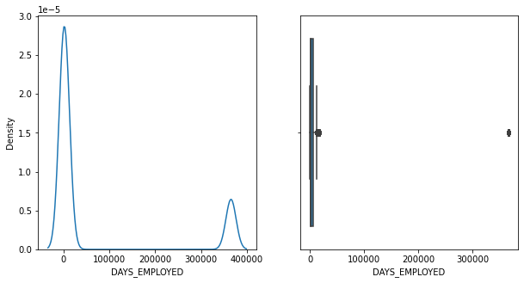
Outlier Analysis..
Days Employed
Found two peaks in data distribution
The lowest peak at 350000 clearly indicating outlier
Found Pensioner(55352) and Unemployed(22) set to large value to represent not applicable feature

Slide 10
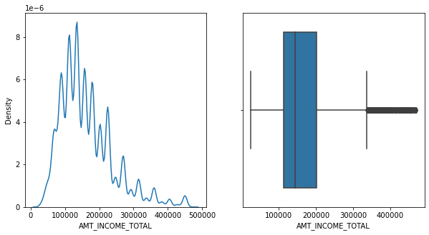
Outlier Analysis..
Income
Large positive skewness indicating outliers. But seems outlier data is pretty small
Seems Like Data entry Issue
Found many local peaks. Data showing categorical nature
Maybe we can perform binning(LOW< MEDIUM, HIGH] to bring them to even scale

Slide 11
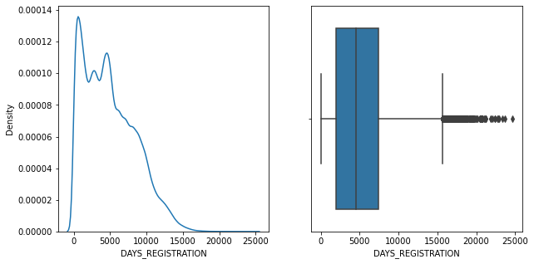
Outlier Analysis..
Days Registration
Negative skewness.
Flatness on the x-axis showing outlier presence
Min value is -24672.0. Which represents 67.6 years(How can someone register before 67 years??)
Only 1 application is recorded this value
May be data entry issue
Record is normal record we can drop it

Slide 12
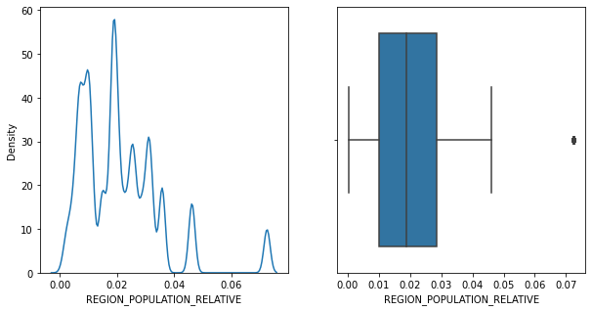
Outlier Analysis..
Density of Region

Slide 13
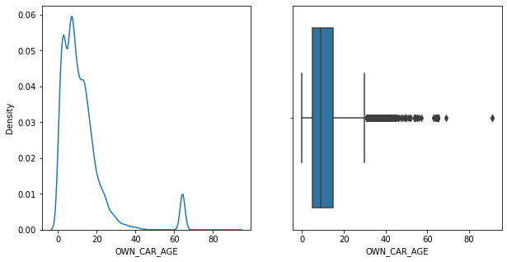
Outlier Analysis..
Car Age

Slide 14
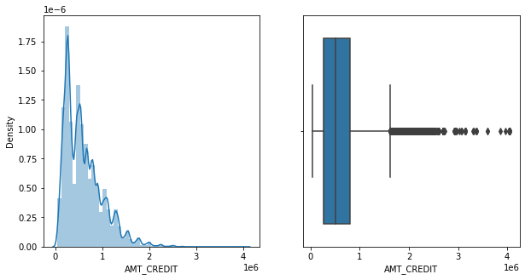
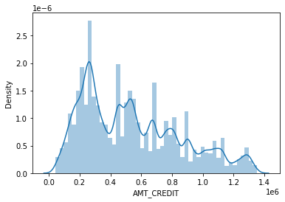
Outlier Analysis..
Credit Amount

Slide 15
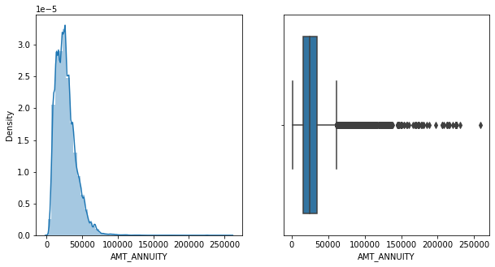
Outlier Analysis..
Annuity

Slide 16
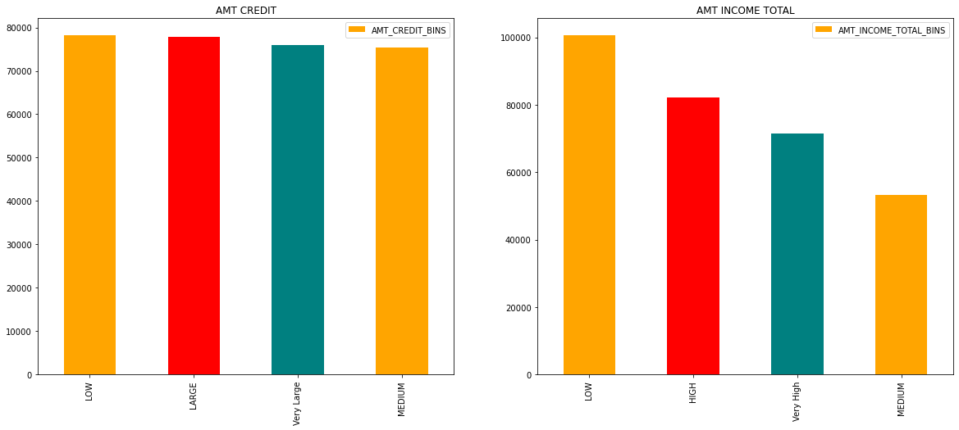
6 Data Creation/ Data Transformation
Performed Binning on Income and Credit data
Low : 25 Percentile
Medium : 50 Percentile
High / Large : 75 Percentile
Very High/ Very large : 100 percentile
AMT CREDIT distribution is uniform among all categories
Received more application from low income group

Slide 17
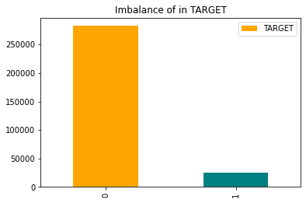
7 Addressing Data Imbalance
~ 8% people are facing difficulty in paying annuity at this at the time of this dataset created. Imbalance is pretty high is TARGET variable

Slide 18
8 Univariant and Bivariate Analysis with Respective to Target 0 , 1

Slide 20
